Slide 1
IBM University Engagement Project Submission
“Exploring the Power of Agentic AI with IBM Granite and LangFlow”

Slide 2

Project Tile – LearnMate
Domain of Project – Education
Student Name | Recent Passport Photo | Email ID | Mobile number [WhatsApp]
D.Vijay Kumar Paliwal |  | 7vijaykumar2006@gmail.com | 8122819525
LearnMate-AI Agent for Personalized Career Pathways

Slide 3
Problem Statement -
The Challenge
Students may feel unsure about which career to pursue.
The number of possible careers and courses can make it difficult to know where to start.
Career guidance often highlights a small number of familiar fields, leaving students unaware of other options.
Students may not know how their interests, talents, current skills, course, and year of study relate to specific careers.
Even when a student chooses a career, they may not know which skills to learn first or how to build experience.
Target Users
Students exploring future careers.
Students who have several interests but no clear career direction.
Students who want to understand the skills required for a career before committing to it.
Why Current Guidance Falls Short
Generic career lists rarely account for a student’s education and current skill level.
Course recommendations may not explain how a course connects to a career goal.
Students need ongoing guidance as their interests and progress change.
Objective
Build an AI agent that learns about the student, filters relevant career options, and creates a learning path for the career the student chooses.

Slide 4
Proposed Solution -
Proposed Solution: LearnMate AI Career Agent
How LearnMate Works
Learns about the student: Asks about interests, skills, talents, strengths, course, year of study, experience, and goals.
Asks follow-up questions: Identifies missing information and asks focused questions before making recommendations.
Explores career options: Uses a broad career catalog to find relevant options, including careers beyond the most familiar choices.
Explains each match: Describes why a career may fit the student and which skills that career commonly requires.
Builds a learning path: Creates an ordered plan with learning topics, course or resource suggestions, practical projects, and milestones.
Adapts with student input: Uses progress and preference updates to propose changes to future steps.
Value to the Student
Makes a large set of career options easier to explore.
Connects the student’s profile to specific career possibilities.
Turns a career choice into clear learning steps.
Keeps the student involved in decisions and changes.

Slide 5
Technology Used
Langflow platform -For designing and orchestrating multi-agent workflows visually
IBM Granite
      Supports the agent’s conversation and follow-up questions.
      Helps explain career matches using the student’s profile.
      Generates skill gap guidance and a staged learning path.
IBM Cloud
IBM Cloud Lite service used.
Purpose in LearnMate: [Hosting, storage, model access].
Keep API credentials on the backend and out of the browser.
RAG– RAG to fetch real data first, then generate intelligent answers, making the Career Agent more trustworthy and effective.
IBM Watsonx.ai - For model deployment, embeddings, and AI governance

Slide 6
LearnMate Agent component Used -
1. Chat Input
Receives the student’s messages.
Collects interests, skills, talents, education details, and goals.
2. Student Profile
Organizes the answers the student has shared.
Keeps profile context available as the conversation continues.
Allows the student to review or update their information.
3. Career Catalog
Provides career names and descriptions.
Supplies relevant skills and learning topics for career matching.
Helps the agent consider options from multiple career areas.
4. IBM watsonx.ai Agent
Sends the relevant student context to IBM Granite.
Asks follow-up questions when key details are missing.
Generates explanations, skill gaps, and learning path suggestions.
5. Progress Tracker
Records completed milestones and student feedback.
6. Chat Output
Displays career suggestions and explanations.
Shows learning steps and milestone updates.
Lets the student review proposed changes.

Slide 7

Role of Agentic AI in the solution
Core role of Agentic AI in LearnMate
Agentic AI guides the student through a connected career discovery process. It uses the student’s answers to choose what to do next, then builds and adapts a learning path with the student’s input.
Builds a picture of the student
The agent gathers interests, skills, talents, strengths, course, year of study, experience, and career goals through conversation. It keeps the answers as context for later steps.
Identifies missing information
Before recommending careers, the agent checks whether it has enough context. If a key detail is missing, it asks a relevant follow-up question instead of guessing.
Explores a broad set of careers
The agent uses a career catalog to consider options across different fields. This can help the student discover careers beyond the few popular choices they may already know.
Filters careers using the student’s profile
It compares the student’s interests, strengths, skills, and education with information about careers. It then presents relevant options and explains why each might fit.
Lets the student guide the choice
The agent answers questions and helps compare options. The student decides which career to explore; the agent does not make that decision for them.
Finds skills to develop
For the chosen career, the agent compares the skills the student reports having with the skills associated with that career. It highlights learning areas to consider, without treating the result as a formal aptitude test.
Creates a personalized learning pathway
The agent turns the chosen career goal into an ordered set of learning steps. A pathway can include topics, course or resource suggestions, practical projects, and milestones, adjusted to the student’s current level and available study time.

Slide 8
Novelty and Uniqueness
LearnMate connects career exploration to the student’s profile and then connects a chosen career to concrete learning steps.
Profile-Based Career Discovery
Starts with the student’s interests, strengths, talents, skills, course, and year of study.
Uses that context to filter career options.
Explains how the student’s profile connects to each suggestion.
Broader Career Exploration
Helps students consider options beyond a short list of familiar careers.
Presents related alternatives so students can compare possible directions.
Gives plain-language descriptions of what careers involve.
Career-to-Learning Path
Identifies skills the student may need to develop.
Organizes learning topics into an ordered pathway.
Adds practical projects and milestones so students can apply what they learn.
Adaptation with Student Feedback
Uses reported progress and changing preferences as new context.
Suggests pathway updates with an explanation.
Leaves changes under the student’s control.

Slide 9
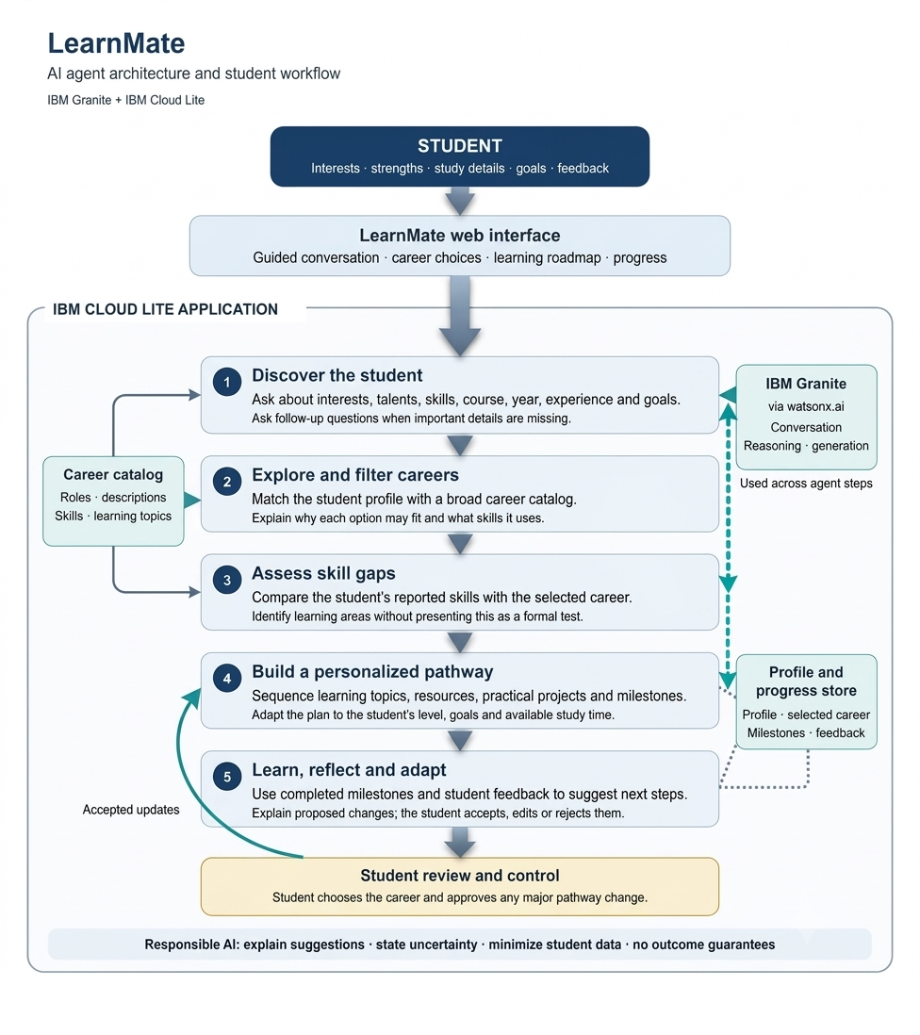
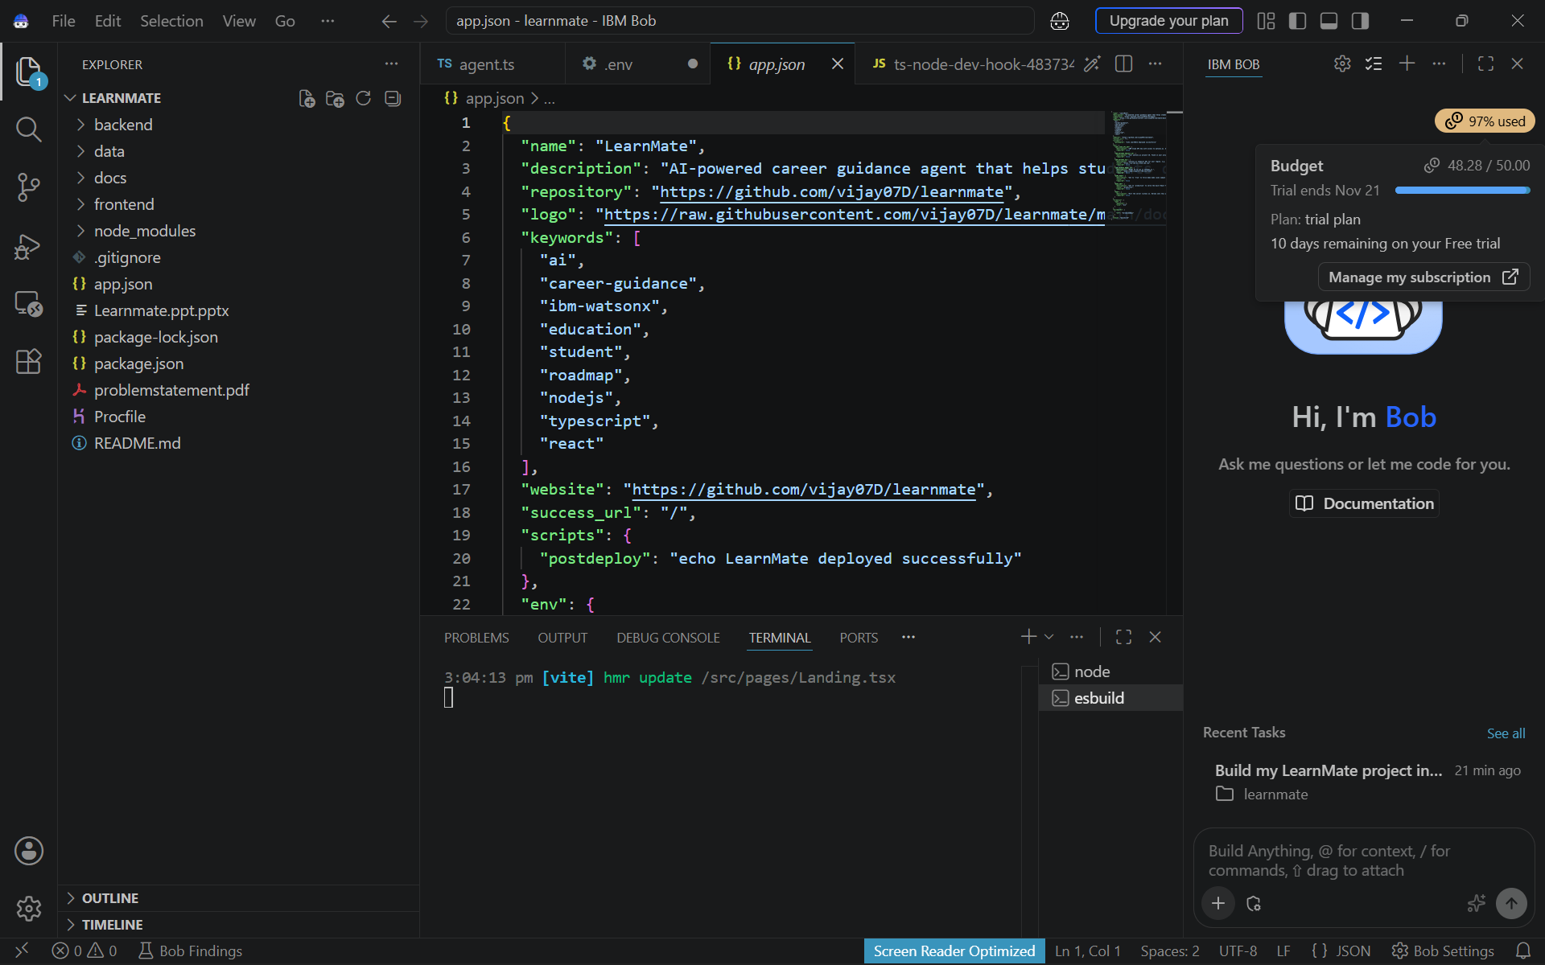
Git Hub Link
https://github.com/vijay07D/learnmate
·
·
·

Slide 10
Future Scope
1.Integration with Wearables & Health Devices –
The system can be integrated with smartwatches and fitness trackers to collect real-time data such as steps, calories burned, heart rate, and sleep patterns. This will enable the Nutrition Agent to provide more accurate and dynamic diet recommendations based on actual user activity and health metrics.
2.AI-Powered Voice Assistant & Multilingual Support –
Enhancing the system with a voice-enabled assistant and support for multiple languages will improve accessibility. Users can interact naturally in their preferred language, making the solution more inclusive and suitable for diverse populations, especially in regions with varied linguistic backgrounds.
·
·
·

Slide 11
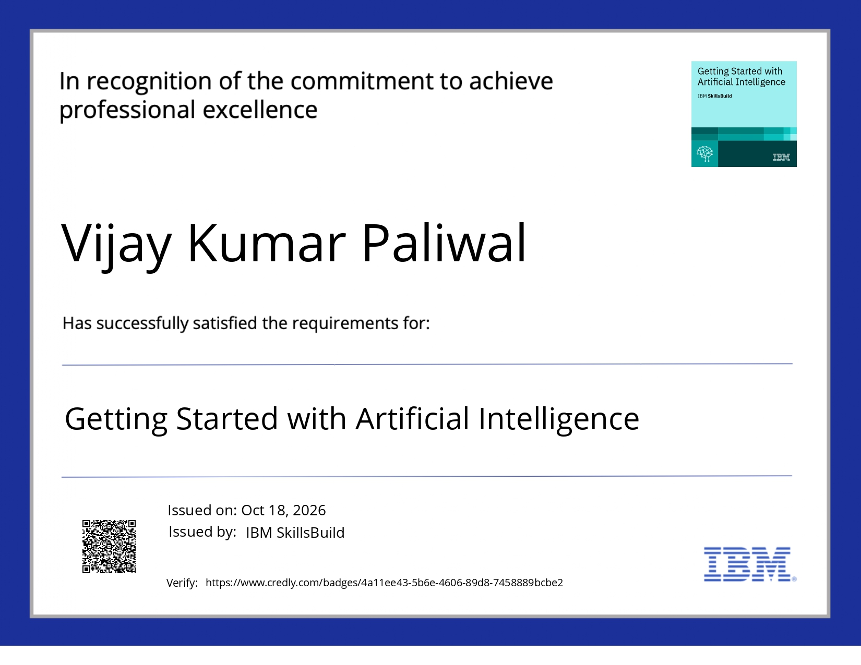
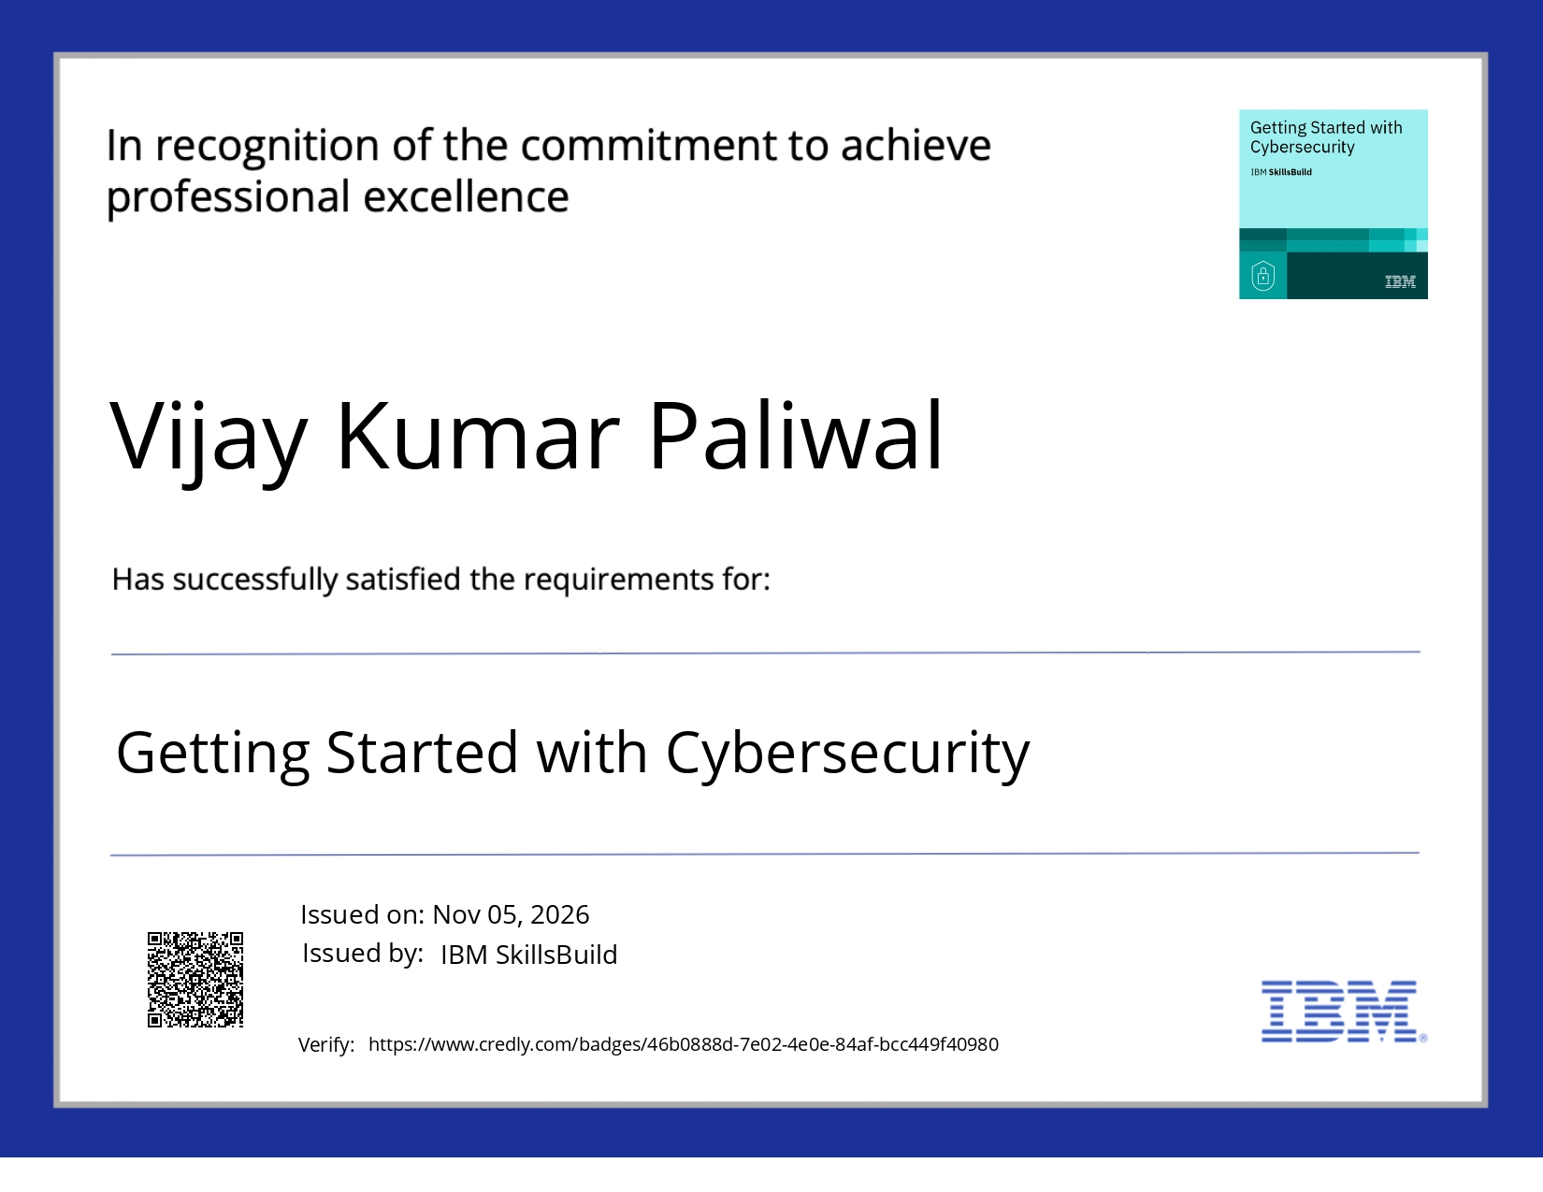
Certificates Earned:
Please add your credly certificate

Slide 12
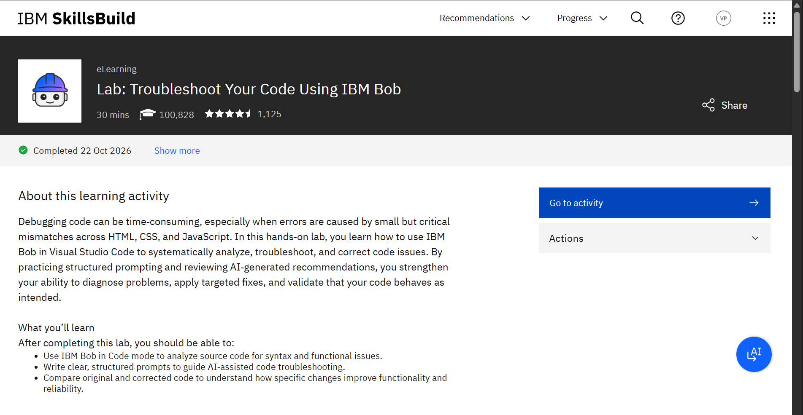
Certificates Earned:​
Didn’t get certificate,so as a proof of completion I am submitting screenshot

Slide 13


